Slide 1
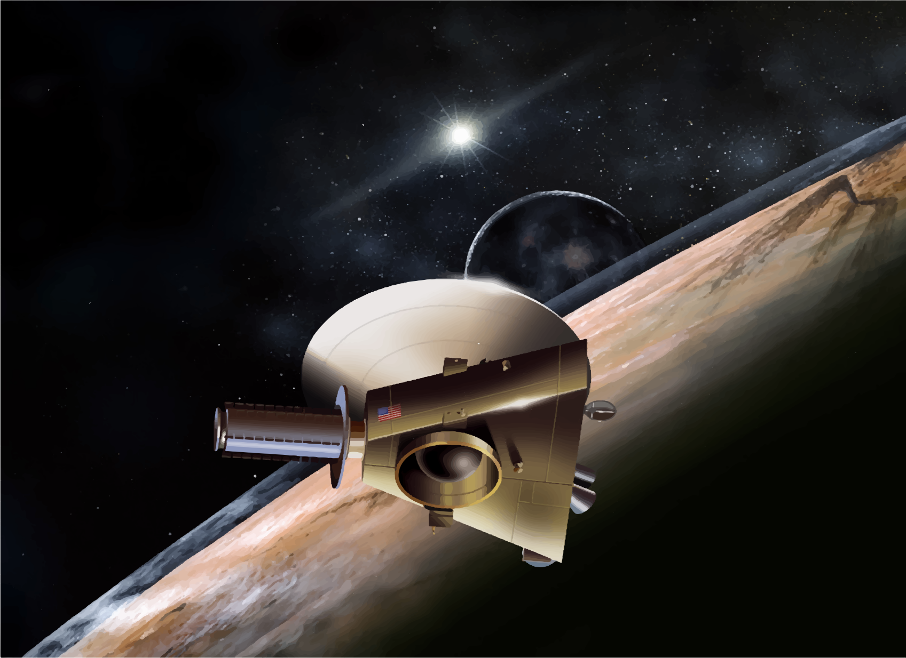
Pluto
Up
Close
NEW HORIZONS PROBE

Slide 2
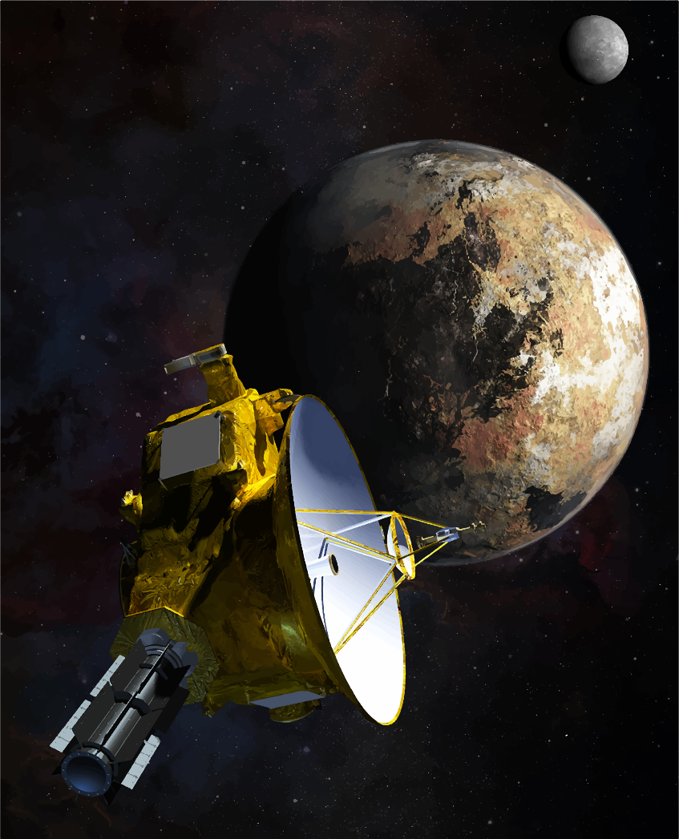
Dwarf Planet
Found in 1930
Reclassified as dwarf planet in 2006
Coldest place in the solar system
Named after Roman god
Notes:
Pluto was discovered on February 18, 1930, by Clyde Tombaugh of the Lowell Observatory

Slide 3
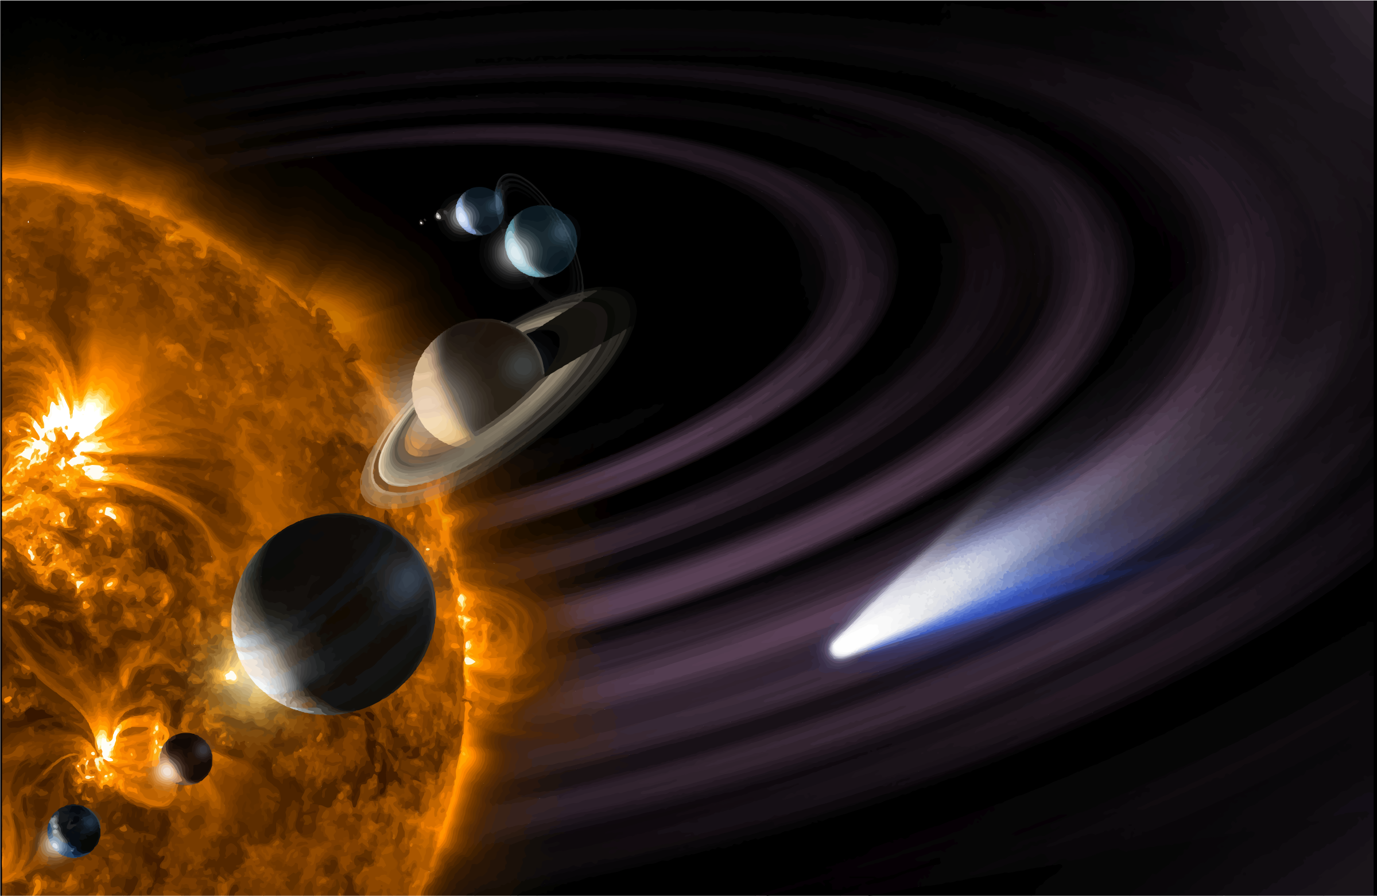
Pluto takes 248 earth years to orbit the sun
Sun rises and sets once a week
Spins opposite direction as the sun
Notes:
It takes five hours for the sun’s rays to reach Pluto. It takes only eight minutes for the sun’s rays to reach Earth.

Slide 4
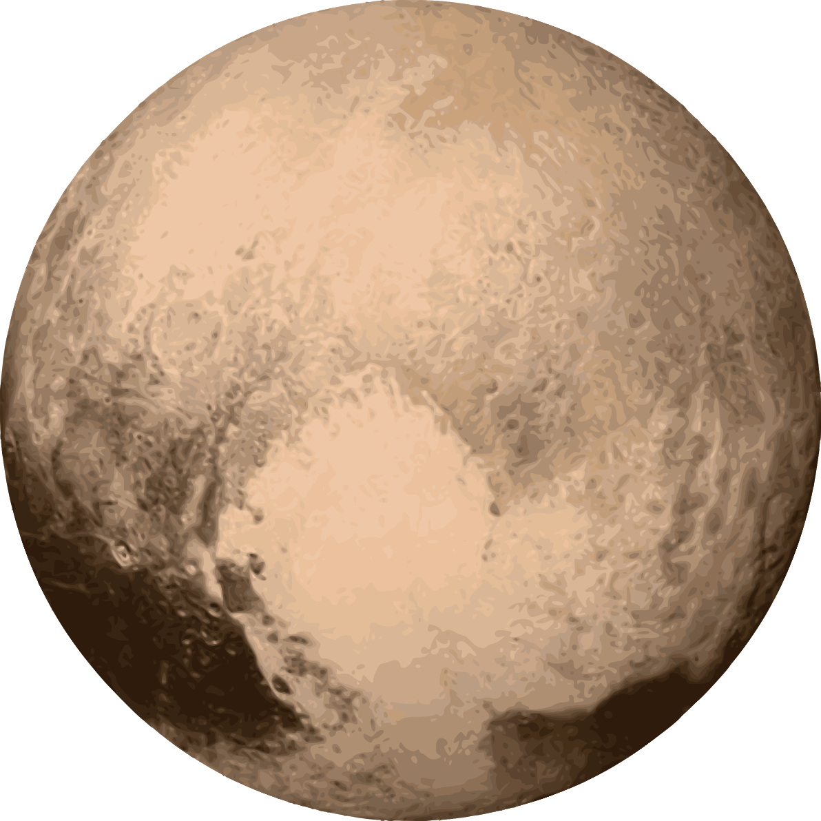
Five Moons

Slide 5
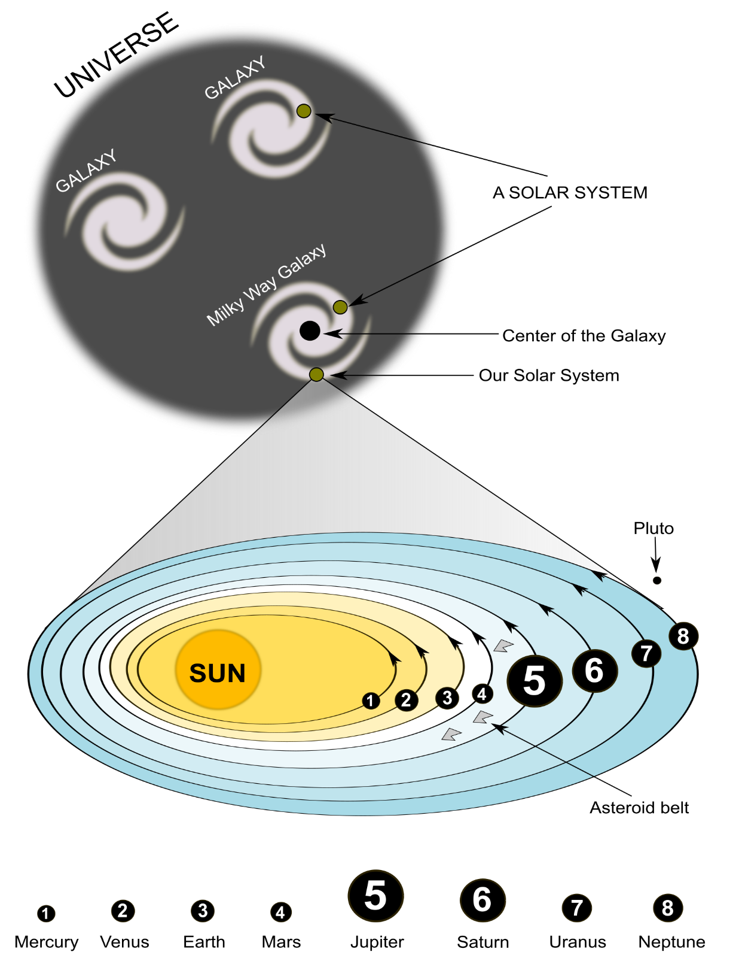
MILKY WAY GALAXY
8 planets and Pluto
More than 200 billion stars
Moves through space at 343 miles per second
PLUTO

